Slide 1

Study, modeling and simulation of pedestrian walk with regard to the improvement of stability and comfort on walkways
School of Electrical & Computer Engineering
Tests on parameter modelling
Pavlos Paris Giakoumakis
AM: 2013030045
Thesis project - Erasmus+ internship at University of Modena & Reggio Emilia (UNIMORE)

Slide 2
Unsorted Modelling

Slide 3
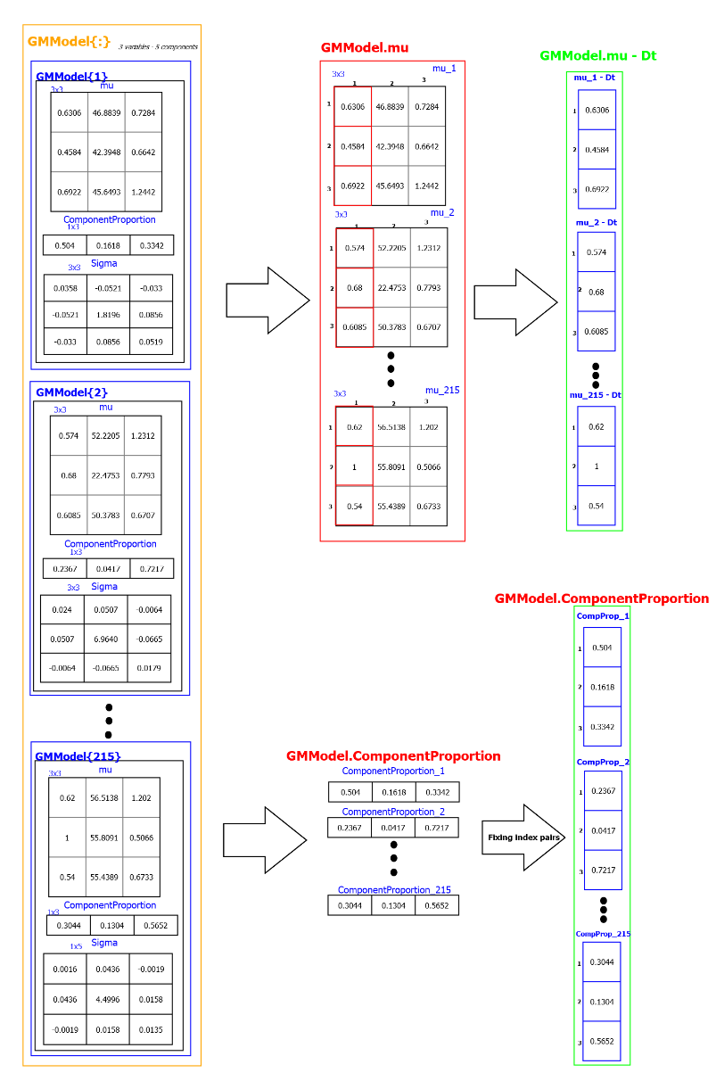

Slide 4
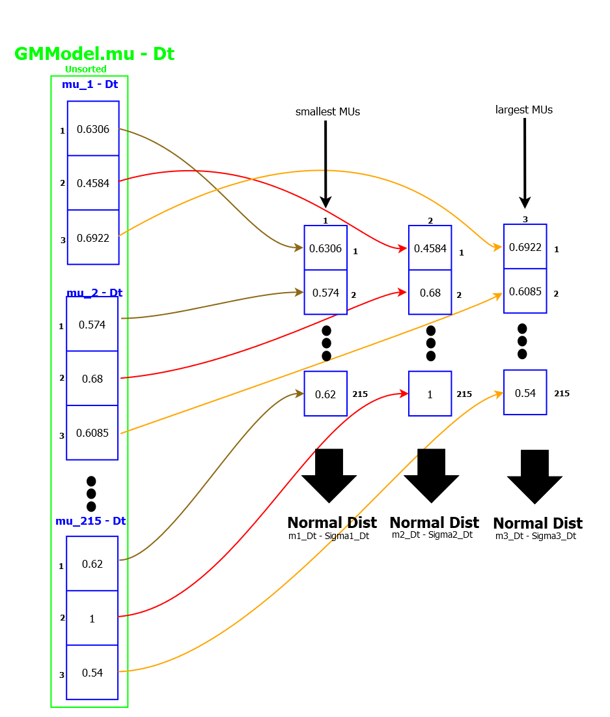

Slide 5
Normal Distributions Fitted on mu - Plot

Slide 6
Normal Distribution Fitted on mu - Plot

Slide 7
Normal Distributions Fitted on mu - Plot

Slide 8
Normal Distributions Fitted on mu - Plot

Slide 9
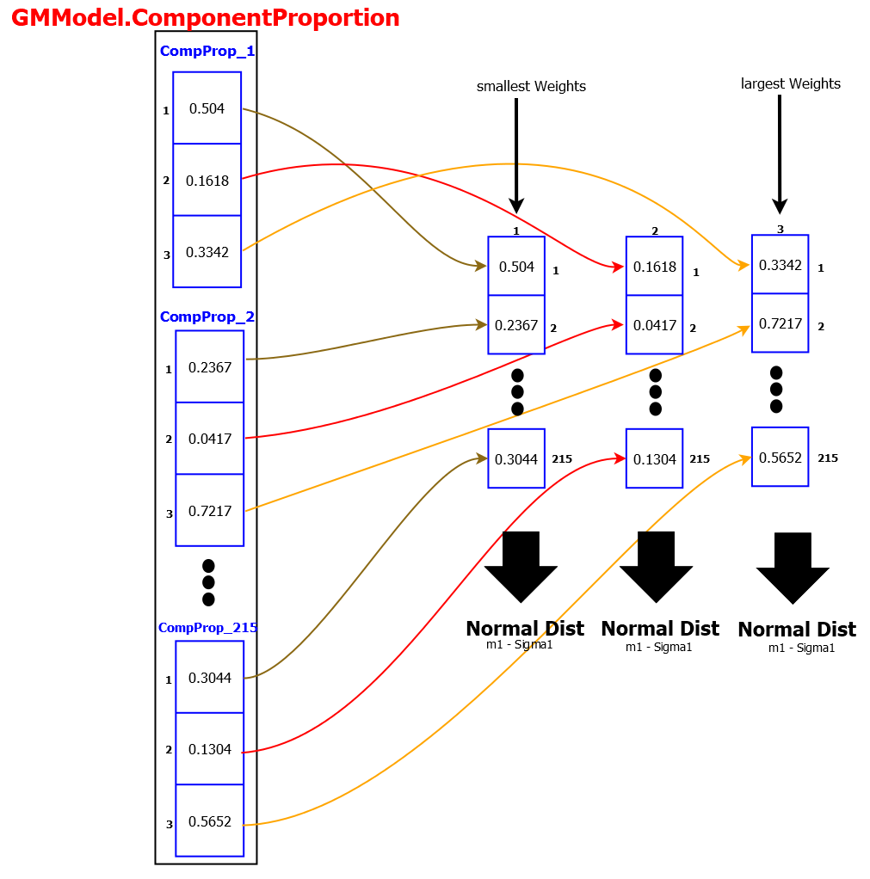

Slide 10
Normal Distributions Fitted on mu - Plot

Slide 11
Normal Distributions Fitted on mu - Plot

Slide 12
Sorted Modelling

Slide 13
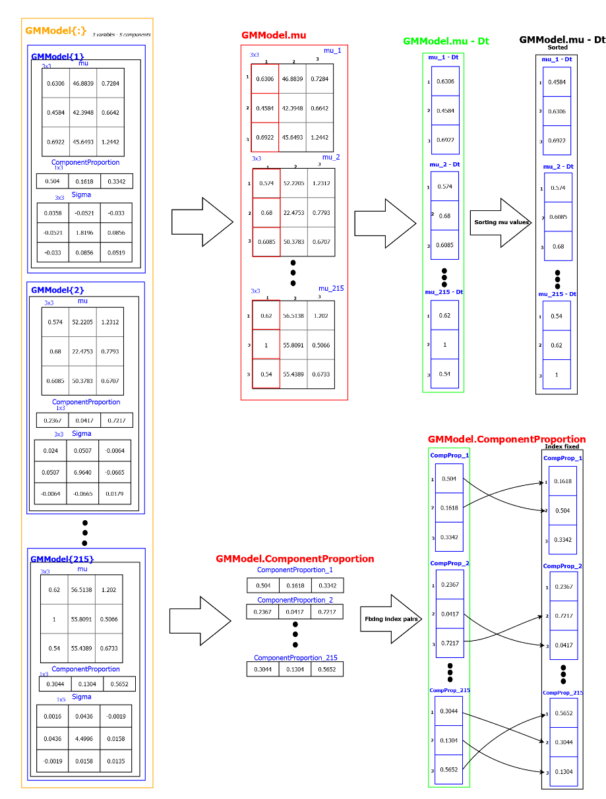

Slide 14
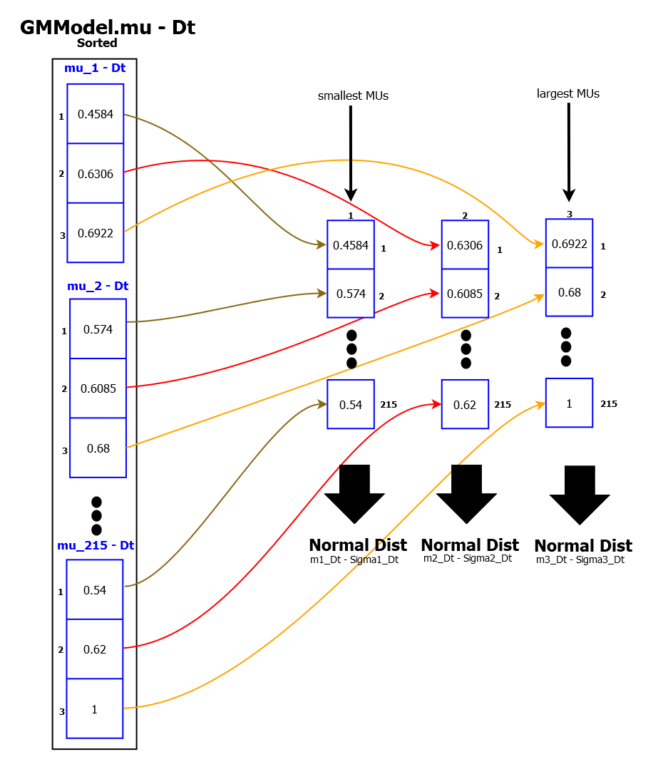

Slide 15
Normal Distributions Fitted on mu - Plot

Slide 16
Normal Distributions Fitted on mu - Plot

Slide 17
Normal Distributions Fitted on mu - Plot

Slide 18
Normal Distributions Fitted on mu - Plot

Slide 19
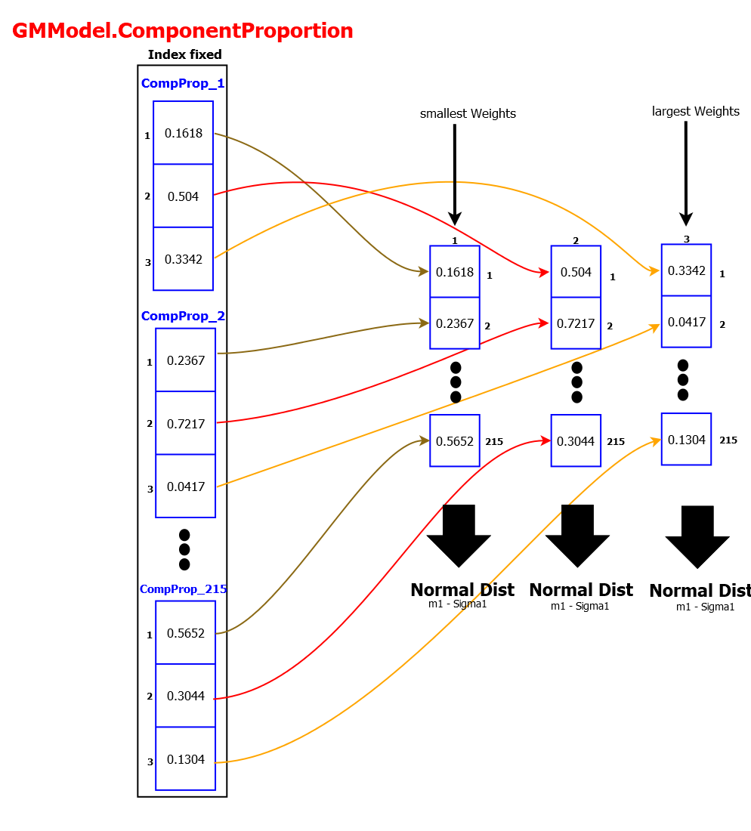

Slide 20
Normal Distributions Fitted on Mixing Probability - Plot

Slide 21
Normal Distributions Fitted on Mixing Probability - Plot

Slide 22
Sigma Modelling

Slide 23

GMM of $2$ components fitted on each differentiated value of Sigma for F, Dt, l - Plot

Slide 24

GMM of $2$ components fitted on Sigma for angle - Plot

